Slide 1
Use Case Diagram
RideEase

Slide 2
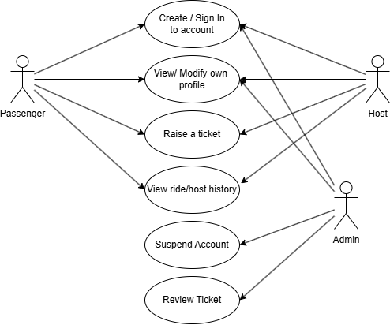
Use Case Diagram
Use Case Diagram
RideEase Application Module 01 : User's Account

Slide 3
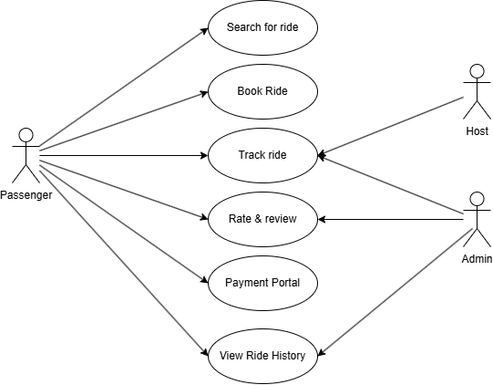
Use Case Diagram
Use Case Diagram
RideEase Application Module 02 : Rider’s Portal

Slide 4
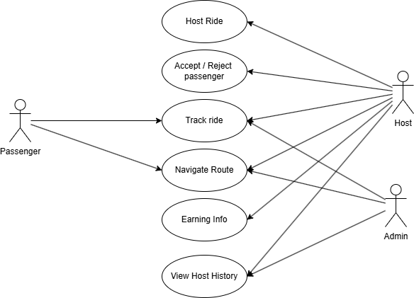
Use Case Diagram
Use Case Diagram
RideEase Application Module 03 : Host’s Portal

